Slide 1

SENTIMENT ANALYSIS OF YELP DATA
BY – YASHIKA BAJAJ
SAURABH THAKRANI
PIYANA MONDAL

Slide 2
PROBLEM DEFINITION
How accurately can the user ratings be predicted based on user review sentiments on Yelp?
Notes:
We will be using sentiment analysis to demonstrate the correlation between user reviews on Yelp and user ratings (in the form of stars)

Slide 3


FINDING THE DATA
Yelp.com freely available in json format
Kaggle – data available in csv files
Notes:
We got the business file from Yelp which was in the JSON format and the user reviews from Kaggle which was already in the csv format. We did not take the data from Kaggle entirely because the data on Kaggle for business file was trimmed and we did not want to use that as it was limiting our analysis.
There are 1000000 rows in review file that we are using out of 5000000 rows while for business we are using the entire file.

Slide 4
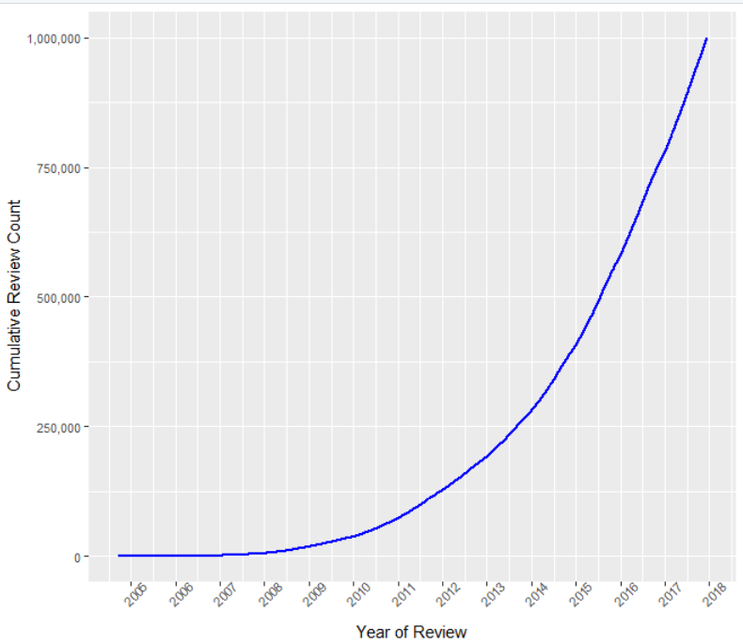
POPULARITY OF YELP
Notes:
Based on the review data
Yelp is the most popular app for searching our favorite cuisines. this graph gives an insight of how the reviews are growing with each passing year.

Slide 5
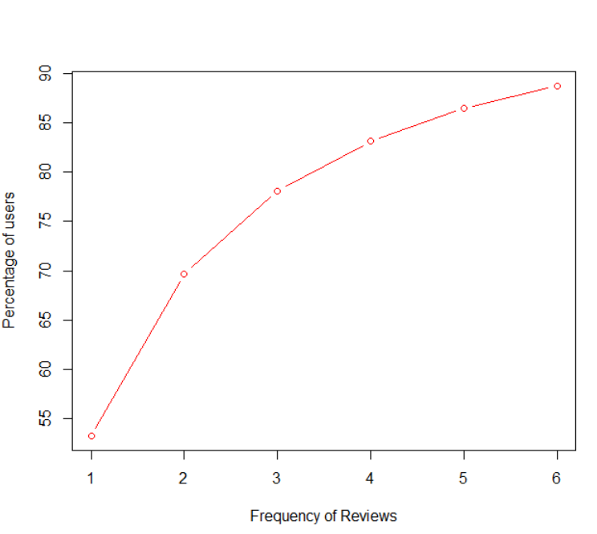
ANALYSING FREQUENT REVIEWERS
Notes:
We wanted to see how frequently users review the restaurants on Yelp. This graph shows that around 55% users have put their reviews only once. We wanted to concentrate more on frequent users so decided to get rid of users with less than 3 reviews but that made us lose a considerable number of reviews, so we decided to just remove the users with single reviews. The resulting data comprised of 86% of reviews from Yelp.

Slide 6
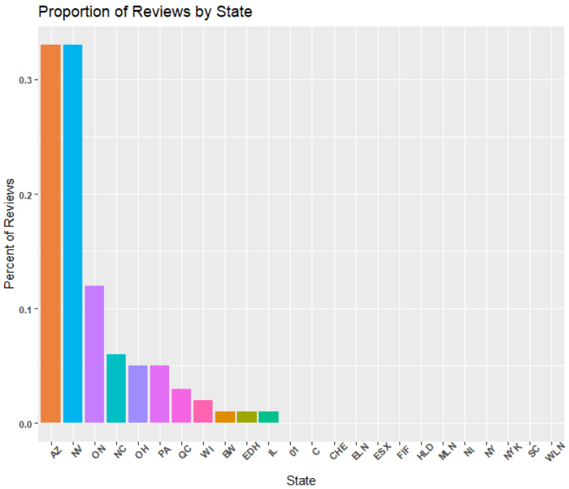
STATE WISE ANALYSIS
Notes:
We now joined the files business and reviews on the basis of business_id. Our next step was to look out for the states where the people have had maximum number of reviews.

Slide 7
SELECTING THE TYPE OF CUISINE
CUISINE | # REVIEWS
MEXICAN | 17217
CHINESE | 9357
PIZZA | 8675
COFFEE & TEA | 8039
ITALIAN | 7827
THAI | 6305
VIETNAMESE | 4284
AMERICAN | 2491
BURGERS | 2320
JAPANESE | 1926
Pizza has roughly 12.67% reviews.
Notes:
We then filtered the top 10 cuisines on Yelp based on the no.of user reviews and decided to work on Pizza because being grad students we all literally survive on Pizzas which makes this relevant for us. Also the number of reviews for pizza out of the other top 10 cuisine was making roughly 12.67%.

Slide 8
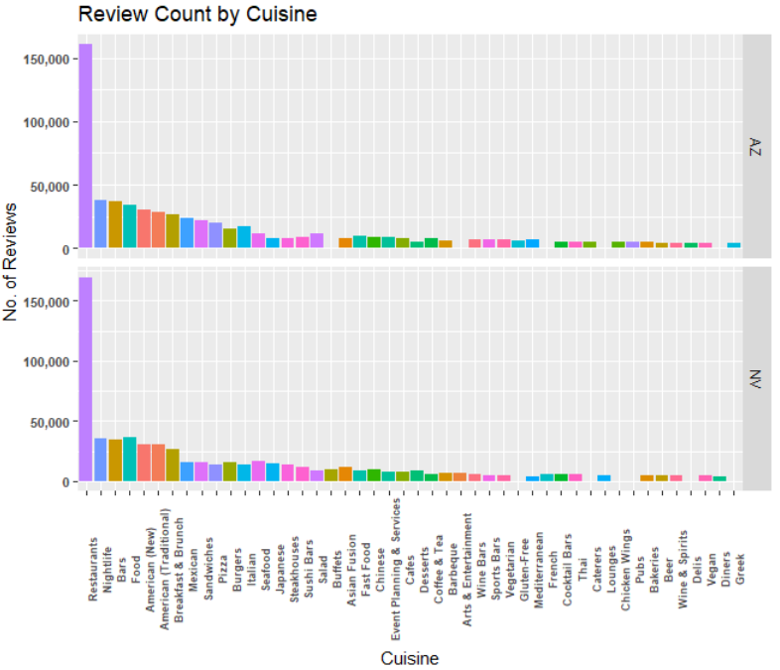
PROPORTION OF PIZZA REVIEWS
Notes:
We wanted to see that in the states Arizona and Nevada what is the proportion of reviews for pizza.

Slide 9
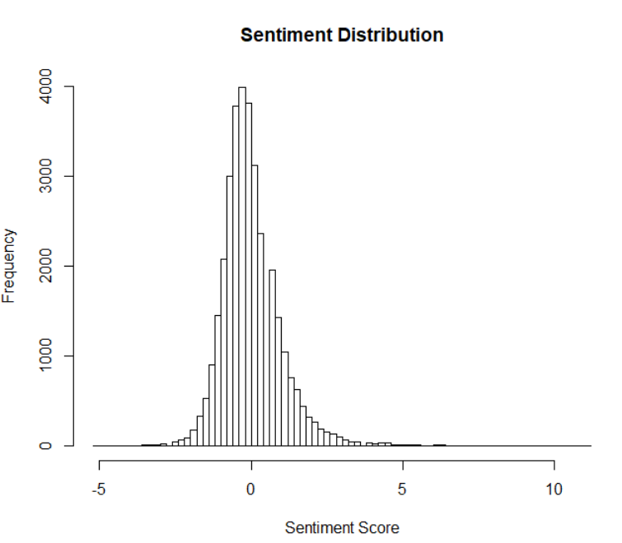
SENTIMENT ANALYSIS OF USER REVIEWS
Notes:
Next we come to the main scope of our project where we are carrying out a sentiment analysis of the user reviews. For this we have first cleaned the reviews removing stop words. We then used the Lexicon from UIC (Prof Bing Liu) for comparison and categorised the positive and negative words. On the basis of this we calculated the overall sentiment score (score for positive words - score for negative words). We then converted this overall sentiment score to z-scores and plotted a histogram for the same. The histogram is almost normally distributed which basically means neutral reviews.

Slide 10
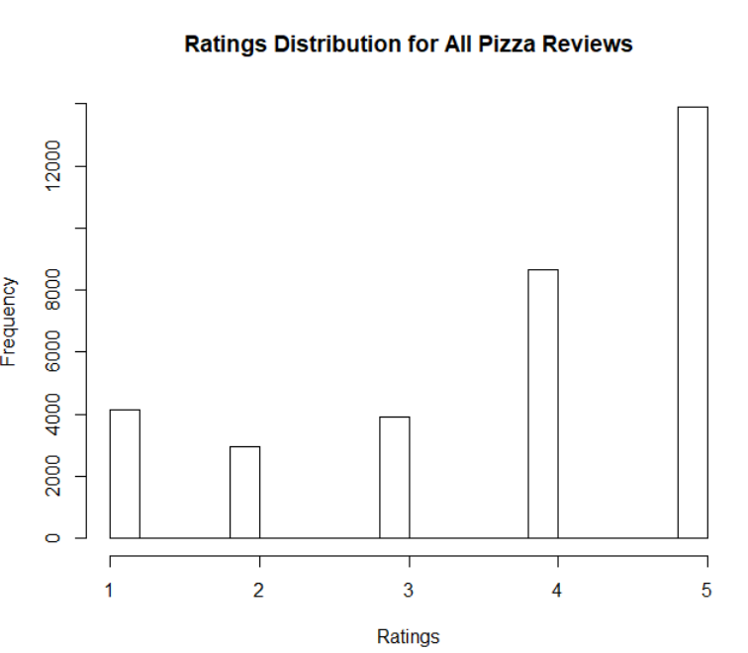
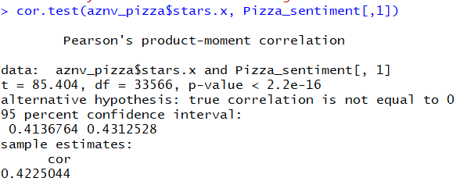
DISTRIBUTION OF USER RATINGS
Notes:
In order to find the correlation between user reviews and user ratings (star ratings) we plotted the distribution of user ratings, from this graph we see that reviews are biased towards positive because max reviews are either for 4 or 5 stars. However, the sentiment analysis has contradictory results. Pearson’s correlation of the user ratings and ratings based on sentiment analysis gives us a 42% correlation. The next question is to see how accurate are the extreme reviews which is 1 or 5 star.

Slide 11
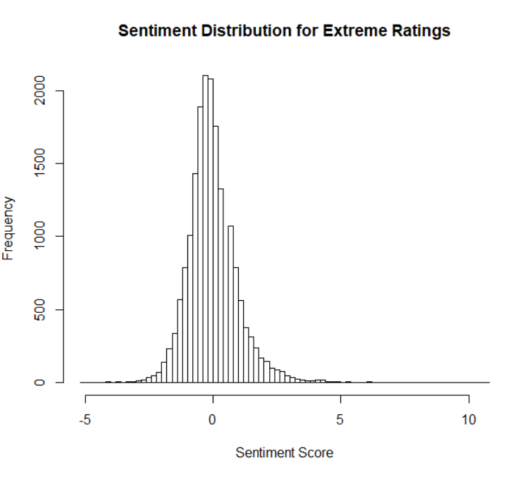
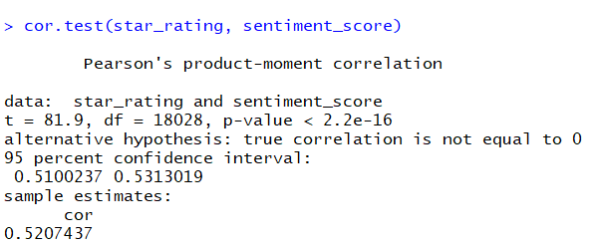
SENTIMENT ANALYSIS FOR EXTREME RATINGS
Notes:
Surprisingly even for the extreme reviews the normality of the review sentiment persists and the correlation with user ratings is only 52% indicating that based on our analysis, user review sentiments are not really the best predictor of user ratings. The correlation improves slightly but still not a good percentage of accuracy. This could be attributed to many factors.

Slide 12
LIMITATIONS OF OUR APPROACH
Assigning equal weightage to all positive words (or all negative words) may not produce accurate sentiment scores.
Analyzing single words without context does not give us a true picture.
Reviews might comprise of reviews of food, ambience, service etc. , so calculating sentiment score for food alone is challenging.
Notes:
Extraordinary and nice are both positive words but they should not ideally carry the same weightage.
Very nice and nice are not same.
The food was not worth - here worth is a positive word but the word ‘not’ makes it negative

Slide 13
THANK YOU

